Slide 1
Coffee business case
IN THESSALONIKI, GREECE

Slide 2
Introduction
Optimal location for a new café business
Focus only on city of Thessaloniki, Greece
Total population ~1M
Boroughs and potential customers are the most essential factors
Research for market openings and No of Cafes in 500m Radius
Location attractiveness, business costs, marketing, rent, borough-exclusiveness

Slide 3
Data Description
As presented above, the map of Thessaloniki has been splited into its boroughs, where Wikipedia and Google Maps have been used as a primary source. Each borough has 4 properties:
the municipal unit that it belongs
the longitude
the latitude
the approximately the number of inhabitants (as per population census of 2011)

Slide 4
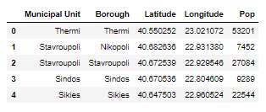
Data Insight (Boroughs Table)
Basic table of all boroughs of Thessaloniki

Slide 5
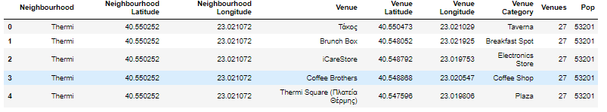
Foursquare API
Based on the given Coordinates of each borough, the Foursquare API returns all venues in the given radius.

Slide 6
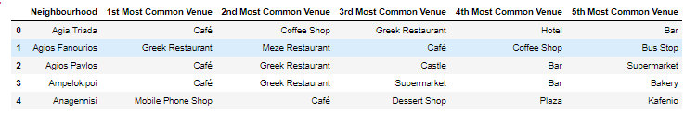
Boroughs Highlights
After data clearance and transformation, a table of all boroughs with most common venue gives the first insight.

Slide 7
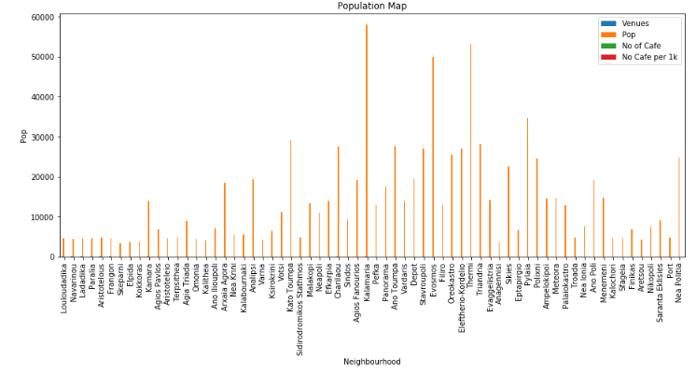
Population in Boroughs

Slide 8
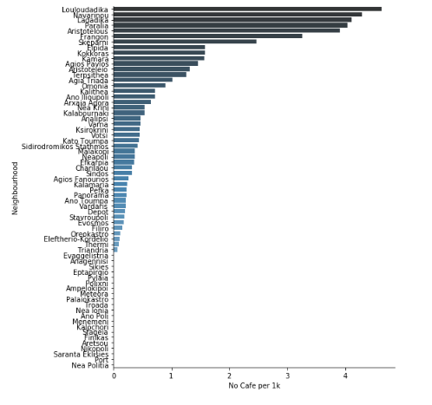
No of Cafes per 1.000 population

Slide 9
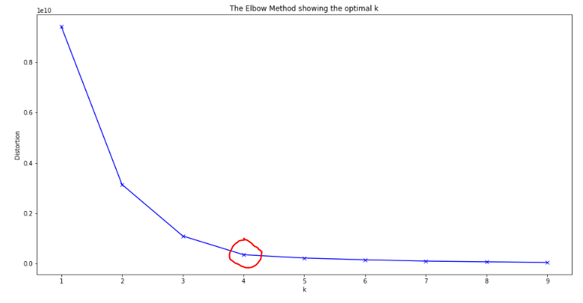
Clustering
Elbow method for optimal k means

Slide 10
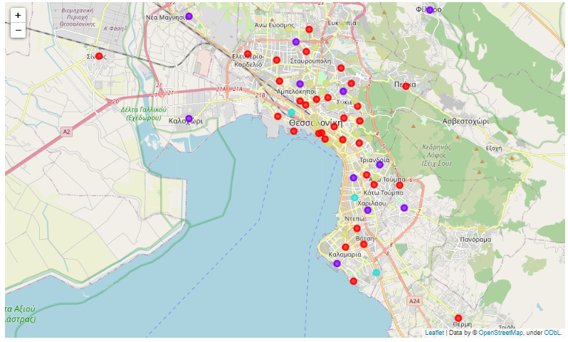
Boroughs clustering

Slide 11
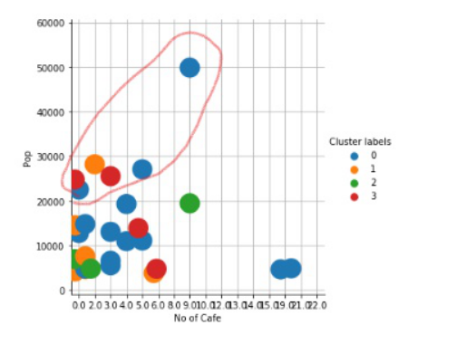
Location +

Slide 12
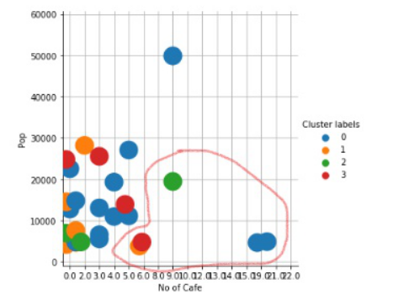
Location -

